Slide 1


Michael Skovsgaard
09-08-2023

Slide 2

Outline
Executive Summary
Introduction
Methodology
Results
Conclusion
Appendix

Slide 3
Executive Summary
Summary of methodologies
- Data Collection via API, Web Scraping and SQL
Data wrangling
Interactive maps with Folium
Predictive analysis for classification models
Summary of all results
- Best model for Predictive Analysis

Slide 4
Introduction
Space X advertises Falcon 9 rocket launches on its website with a cost of 62 million dollars; other providers cost upward of 165 million dollars each, much of the savings is because Space X can reuse the first stage. Therefore, if we can determine if the first stage will land, we can determine the cost of a launch.
In this project we want to create and compare serval classification models to find out which one best predict if the Falcon 9 will land.

Slide 5

Section 1

Slide 6
Methodology
Data collection methodology:
Via SpaceX Rest API and Web Scraping from Wikipedia
Perform data wrangling
Removing irrelevant columns and missing values.
One hot encoding to prepare data for classification.
Perform exploratory data analysis (EDA) using visualization and SQL
- Scatterplots and bar graphs to understand patterns in the data.
Perform interactive visual analytics using Folium and Plotly Dash
- Using Plotly Dash and Folium for Data visualization.
Perform predictive analysis using classification models
- Build and compare classification models (Decision tree, SVM, Logistic Regression and ..)

Slide 7
Data Collection
Data was collected through SpaceX Rest API and Web scraping from Wikipedia.
Pull data from API and wikipedia
Filtering irrelevant data
Create Dataframe using the requested data
Exporting to flat CSV file

Slide 8
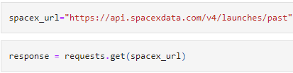
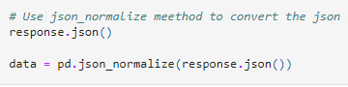
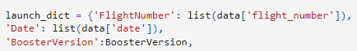
Data Collection – SpaceX API
SpaceX get request, normalization and filtering.
Github Url
here

Slide 9
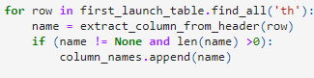
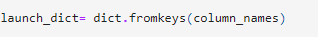
Data Collection - Scraping
Creating a BeautifulSoup object
Find all tables in object
Choosing third table
Extracting column names from Soup object
Creating a dictionary using column names
Creating a Dataframe
Github Url

Slide 10
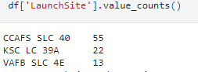
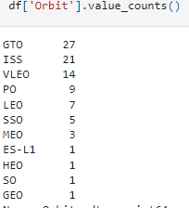
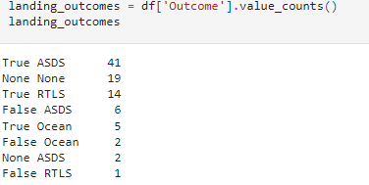
Data Wrangling
Process
Checking the count of Launch Site, Orbit and Outcome using value_counts function.
Assigning the negative outcomes as “bad outcomes”.
Using “bad outcomes” to create a new variable “landing class” as 0 if the Outcome was a failure and 1 if the Outcome was a success.
Saving to CSV file.
Github Url

Slide 11
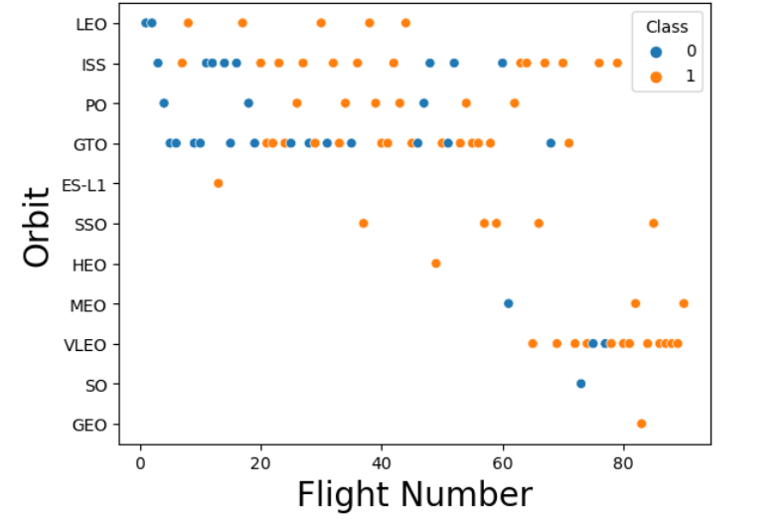
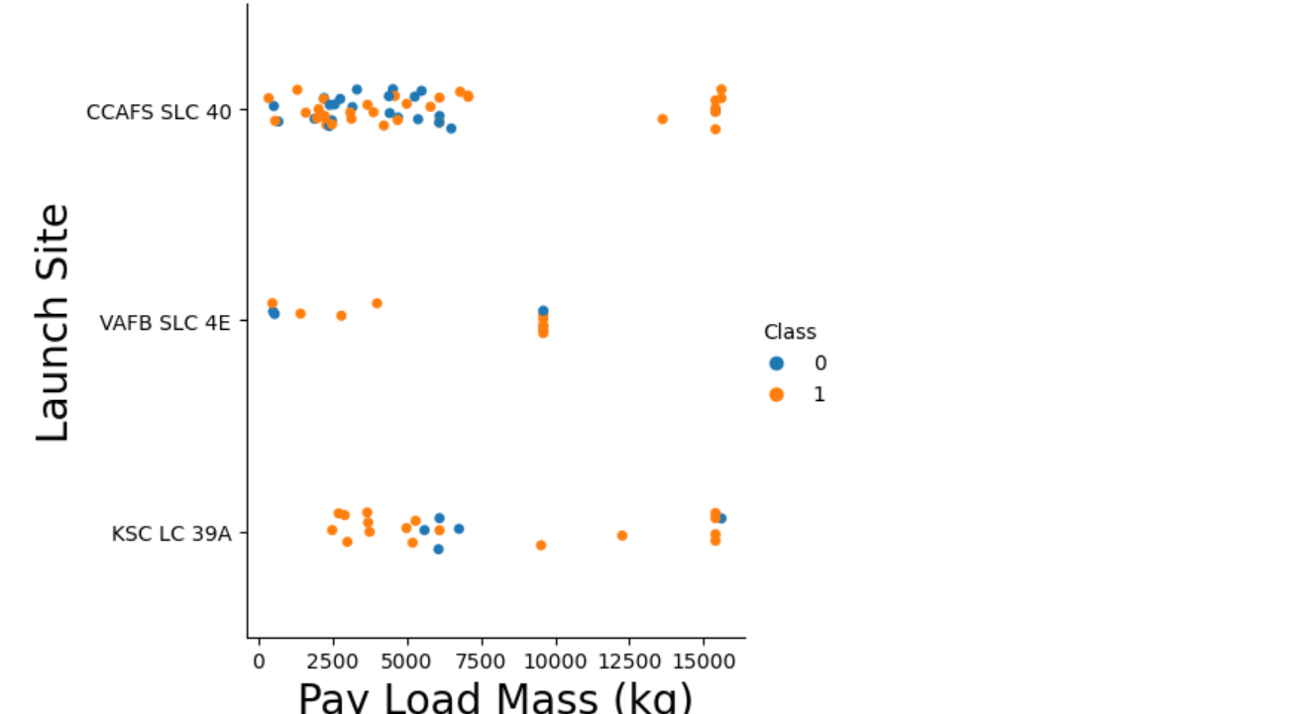
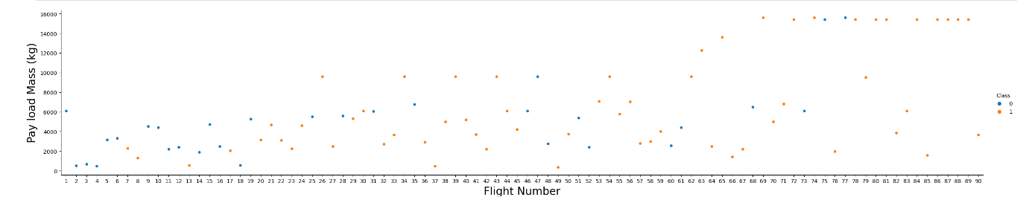
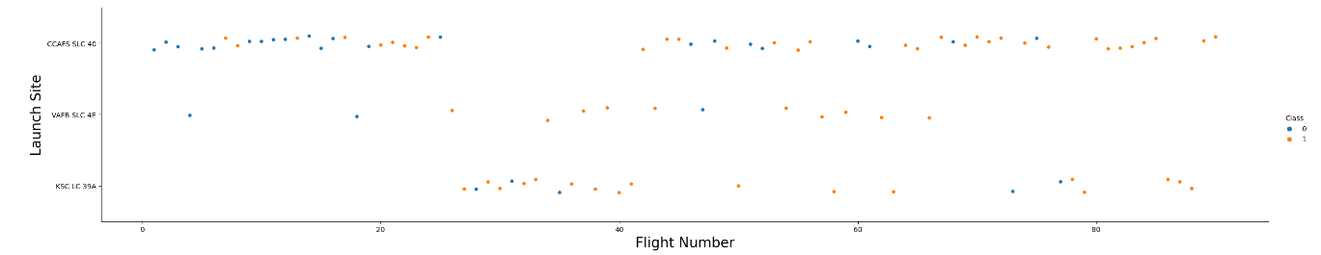
EDA with Data Visualization(1/2)
Scatterplot with Flight Number vs. Launch Site and Class (Success or Failure)
Scatterplots revealed the relationship between Launch Site, Payload Mass and Class
Github Url

Slide 12
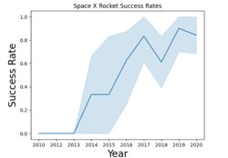
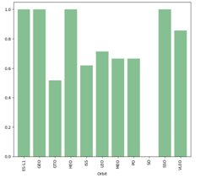
EDA with Data Visualization(2/2)
Lineplot of Year and Success rate used show trends that can aid predictions.
Barplot of Success rate vs. Orbit type displays the success rate for each orbit missions.
Github Url
Github Url

Slide 13
EDA with SQL (1/2)
%sql SELECT Distinct(Launch_Site) FROM SPACEXTBL
%sql SELECT * from SPACEXTBL WHERE Launch_Site LIKE 'CCA%'LIMIT 5
%sql SELECT SUM(PAYLOAD_MASS__KG_) FROM SPACEXTBL WHERE CUSTOMER ='NASA (CRS)’
%sql SELECT AVG(PAYLOAD_MASS__KG_) FROM SPACEXTBL WHERE booster_version = "F9 v1.1“
%sql SELECT MIN(DATE, landing_outcome FROM SPACEXTBL WHERE landing_outcome = "Success"
%sql SELECT Booster_Version FROM SPACEXTBL WHERE landing_outcome = "Success (drone ship)" \
AND PAYLOAD_MASS__KG_ > 4000 AND PAYLOAD_MASS__KG_ < 6000;
%sql SELECT Mission_Outcome, count(Mission_outcome) AS "Successful Missions" FROM SPACEXTBL \
WHERE Mission_outcome LIKE 'Success%' \
GROUP BY Mission_Outcome

Slide 14
EDA with SQL (2/2)
%sql SELECT Booster_Version FROM SPACEXTBL \
where PAYLOAD_MASS__KG_ = (SELECT MAX(PAYLOAD_MASS__KG_) FROM SPACEXTBL)
%sql SELECT substr(Date, 4, 2) AS Month, Booster_Version, Launch_Site FROM SPACEXTBL \
where landing_outcome = "Failure (Drone Ship)" AND year(DATE) = substr(Date,7,4)='2015’
%sql SELECT landing_outcome, count(landing_outcome) FROM SPACEXTBL \
WHERE DATE BETWEEN '2010-06-04' AND '2017-03-20' \
group by landing_outcome\
order by count(landing_outcome) desc
Github Url

Slide 15
Building an interactive map with Folium
Vizualisation of Launch Data in an interactive map using the Longitude and Latitude coordinates for each launch site. Adding a marker for each launch site with label.
Assigning Green and Red labels to markes using the launch_outcomes dataframe.

Slide 16
Built an interactive dashboard with Flask and Dash
Building a dashbard with Flask and Dash
Using piecharts to show total launches by launch site.
Scatterplots showing Outcome vs Payload Mass

Slide 17
Predictive Analysis (Classification)
The process of building the model included loading data and packages, standardizing the data, split the data into training and test data, using GridSearchCV and train our model.
In the Evaluation phase we checked the accuracy of the model, found the best hyperparameters and plotted the confusion matrix.
In the comparison phase we listed the accuracy for each model in a Dataframe and listed them according to the accuracy to easily compare which model performed yielded the best results.
Building the model
Evaluating the model
Finding best performing model
Best model

Slide 18
Results
Exploratory data analysis results
Interactive analytics demo in screenshots
Predictive analysis results

Slide 19

Section 2

Slide 20
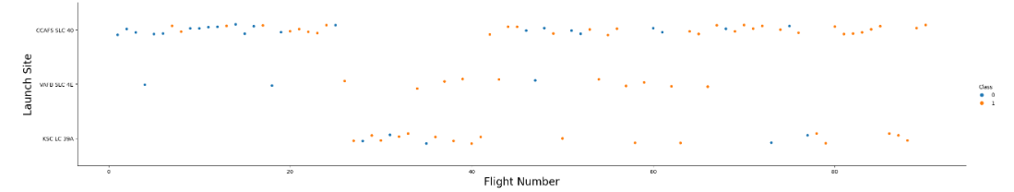
Flight Number vs. Launch Site
With higher Flight Number the success rate seems to be improving

Slide 21
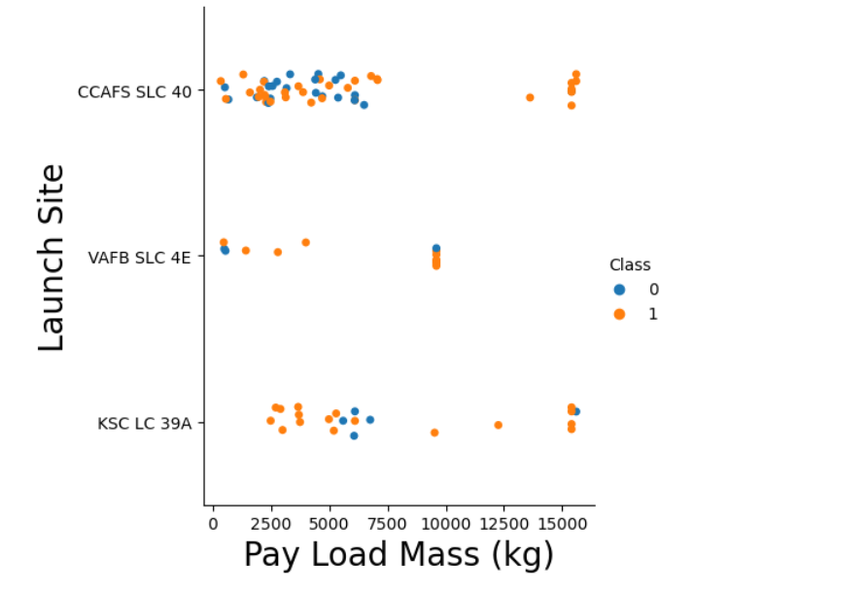
Payload vs. Launch Site
It seems the higher the PayloadMass the higher chance of success for the rocket.
However, this plot is not enough to determine a definite relationsship.

Slide 22
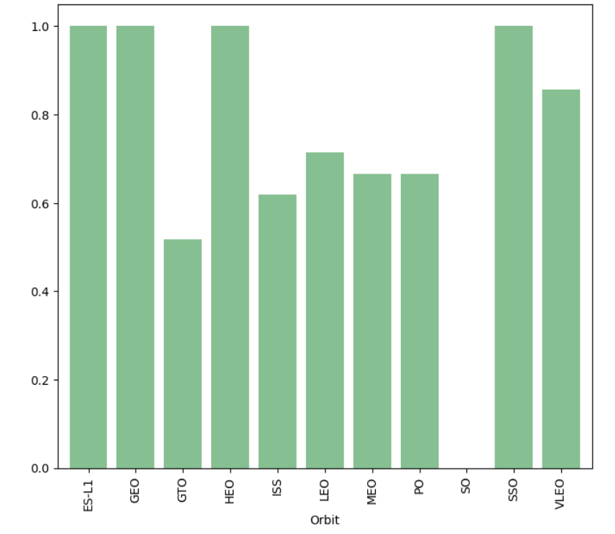
Success Rate vs. Orbit Type
The Orbit type with the highest successrate is ES-L1, GEO, HEO and SSO.

Slide 23
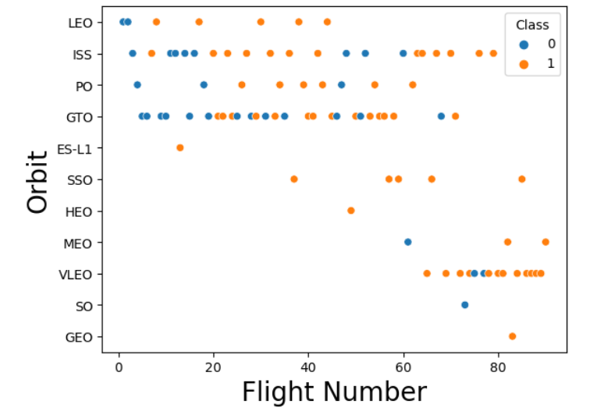
Flight Number vs. Orbit Type
For LEO, it seems that the successrate increases with flightnumber. However, for GTO there seems to be no relationship between orbit and flightnumber.

Slide 24
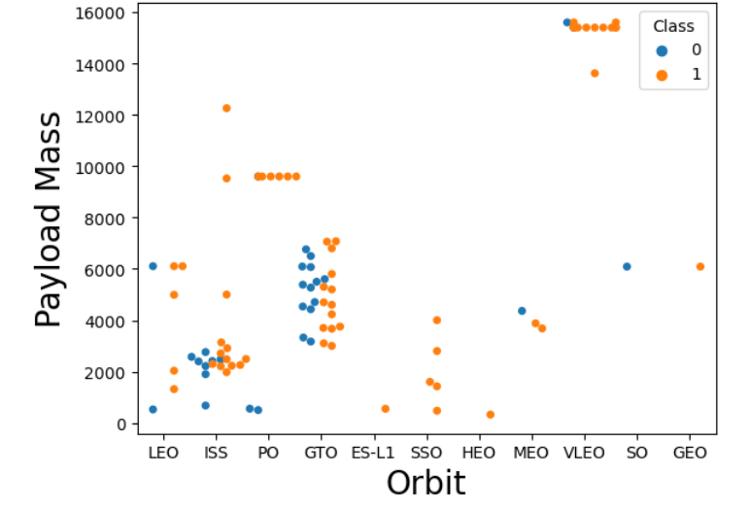
Payload vs. Orbit Type
From this scatterplot we see that heavy payload mass influence the success of the mission for some Orbits, such as MEO, and VLEO.
For Orbits an increase in payload mass did not affect the success.

Slide 25
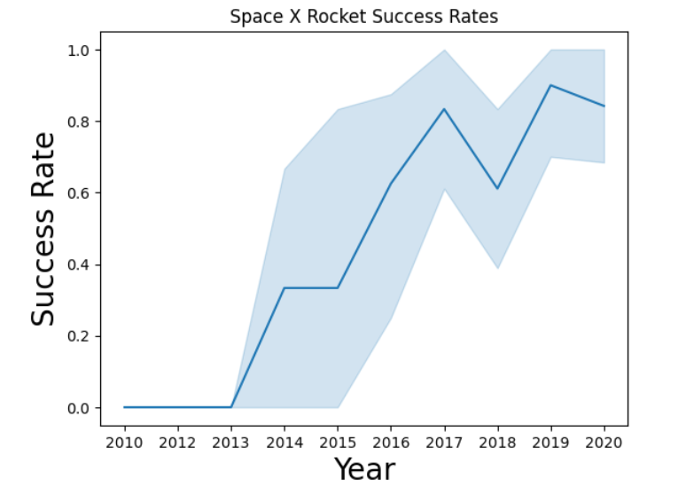
Launch Success Yearly Trend
This line chart illustrates that as year increases the successrate seems to increase as well.

Slide 26
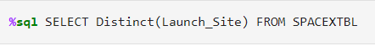
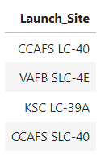
All Launch Site Names

Slide 27
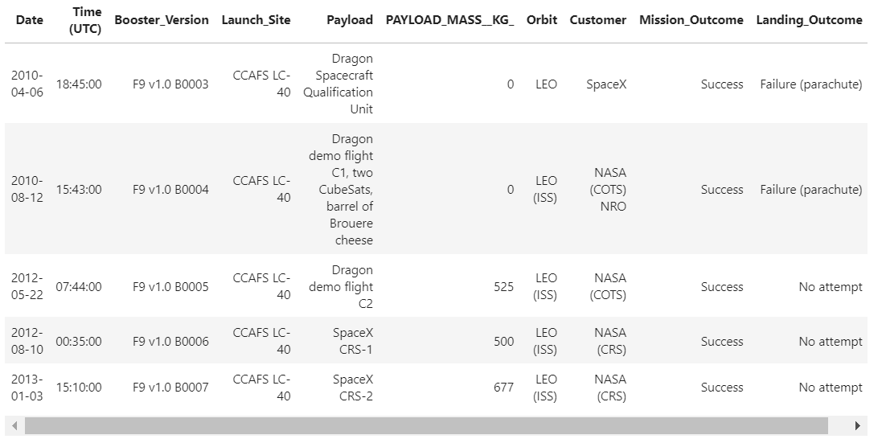
Launch Site Names Begin with 'CCA'

Slide 28
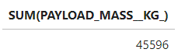
Total Payload Mass

Slide 29
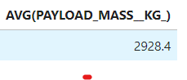
Average Payload Mass by F9 v1.1

Slide 30
First Successful Ground Landing Date
Find the dates of the first successful landing outcome on ground pad
Present your query result with a short explanation here

Slide 31
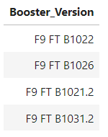
Successful Drone Ship Landing with Payload between 4000 and 6000

Slide 32
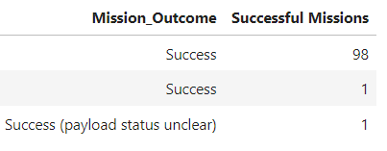
Total Number of Successful Outcomes

Slide 33
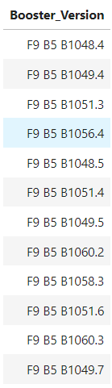
Boosters Carried Maximum Payload

Slide 34
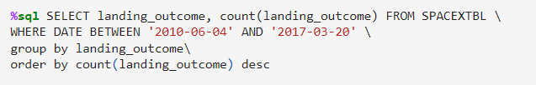
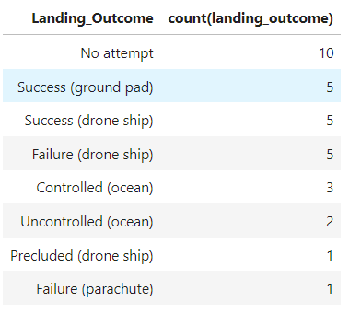
Rank Landing Outcomes Between 2010-06-04 and 2017-03-20

Slide 35

Section 3

Slide 36
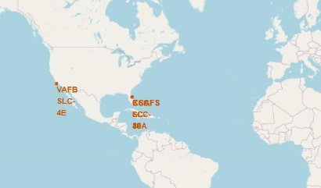
Build an Interactive Map with Folium
We see that the launch sties are all located in Florida or California in USA

Slide 37
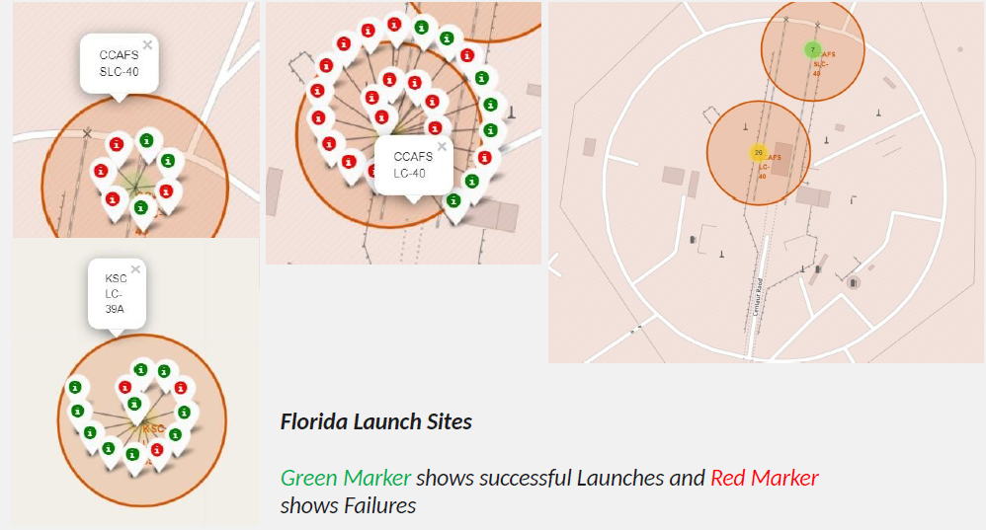
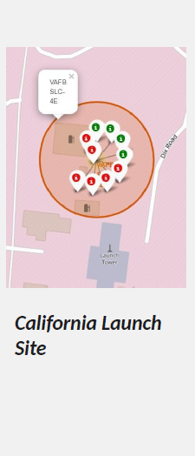
Build an Interactive Map with Folium

Slide 38

Section 4

Slide 39
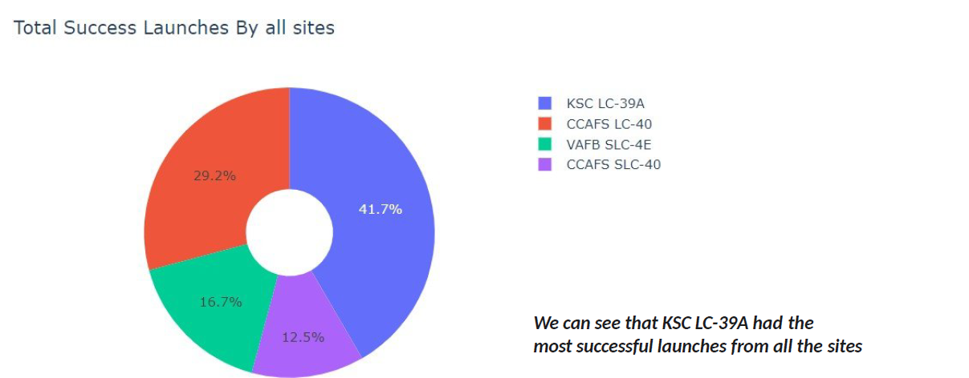
Build a Dashboard with Plotly Dash

Slide 40
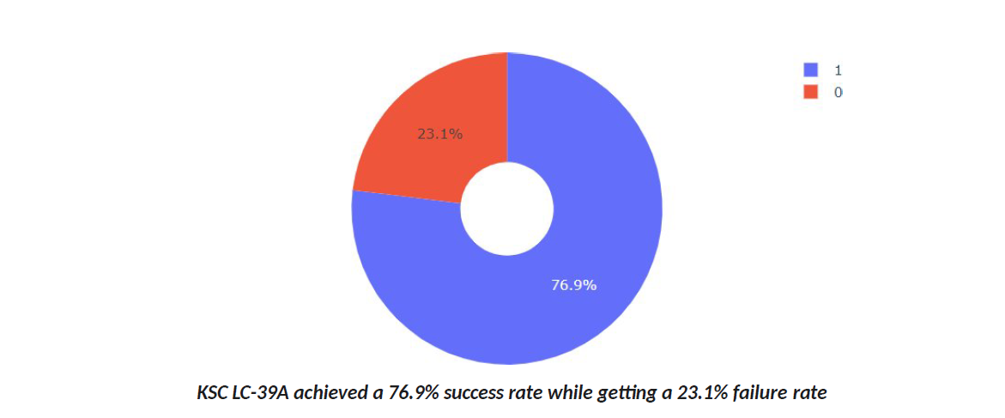
Build a Dashboard with Plotly Dash

Slide 41
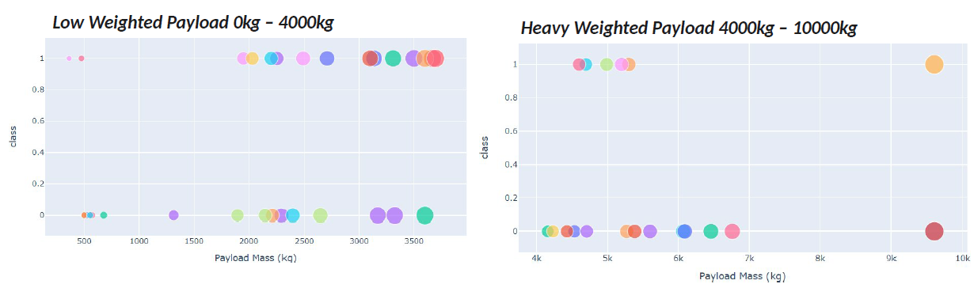
Build a Dashboard with Plotly Dash
This illustrates the success rates for low weighted payloads is higher than the heavy weighted payloads

Slide 42

Section 5

Slide 43
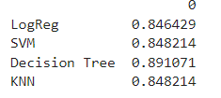
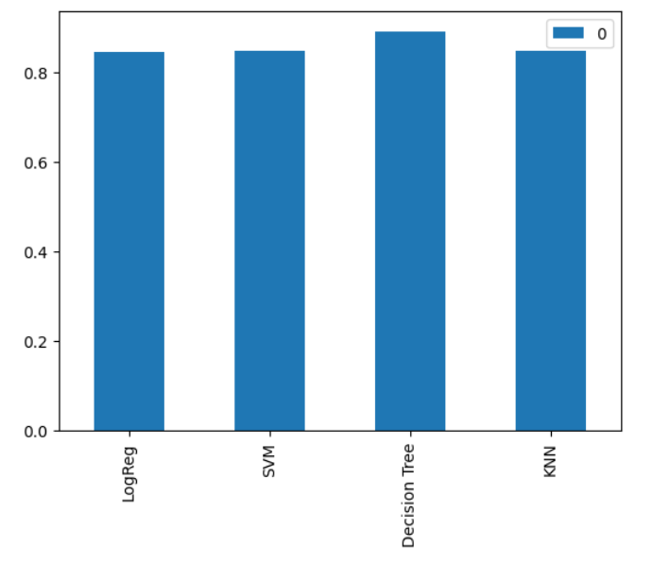
Classification Accuracy
In this project, A Decision Tree classification model performed a little better than the Logistic Regression, SVM and KNN classification models.

Slide 44
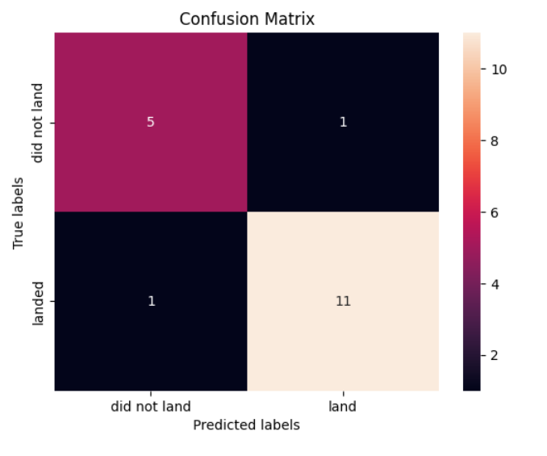
Confusion Matrix
The confusion illustrates the prediction from the classification model.
From this we can see that the model correctly predicted 11 landings and misclassified 1 landing as a failure.
Furthermore, we can see that the model correctly predicted 5 failures and misclassified 1 failure as a landing.

Slide 45

Conclusions
The Decision Tree Classifier Algorithm performed better than SVM, Logistic Regression and KNN for this dataset.
KSC LC-39A has had the most successful launches among the launch sites.
Orbits GEO, HEO, ES-L1 and SSO has highest sucessrate.
…

Slide 46


